Slide 1
Zurich HDAWG GUI (AWG_gUI.py)
Richard McManus
March 2023

Slide 2
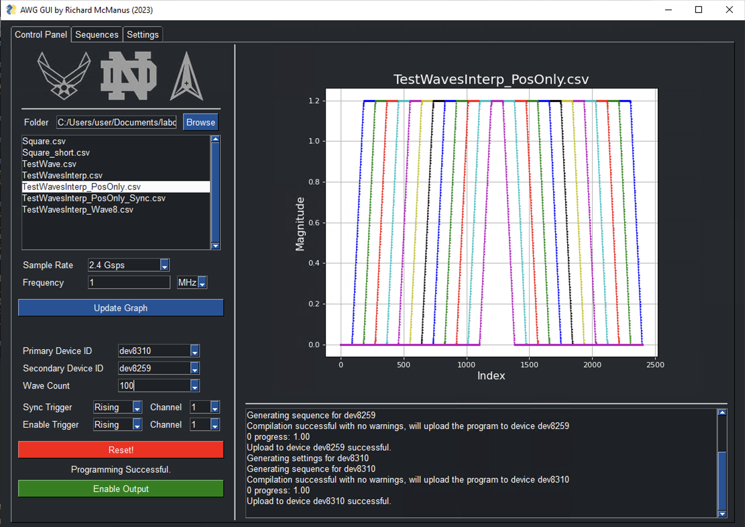
Control Panel
Browse for waveform folder
Load waveforms from .csv file
Specify:
primary and secondary devices
sample rate and frequency of waveforms
duration of playback
triggers
sync trigger between devices
enable trigger to initiate playback

Slide 3
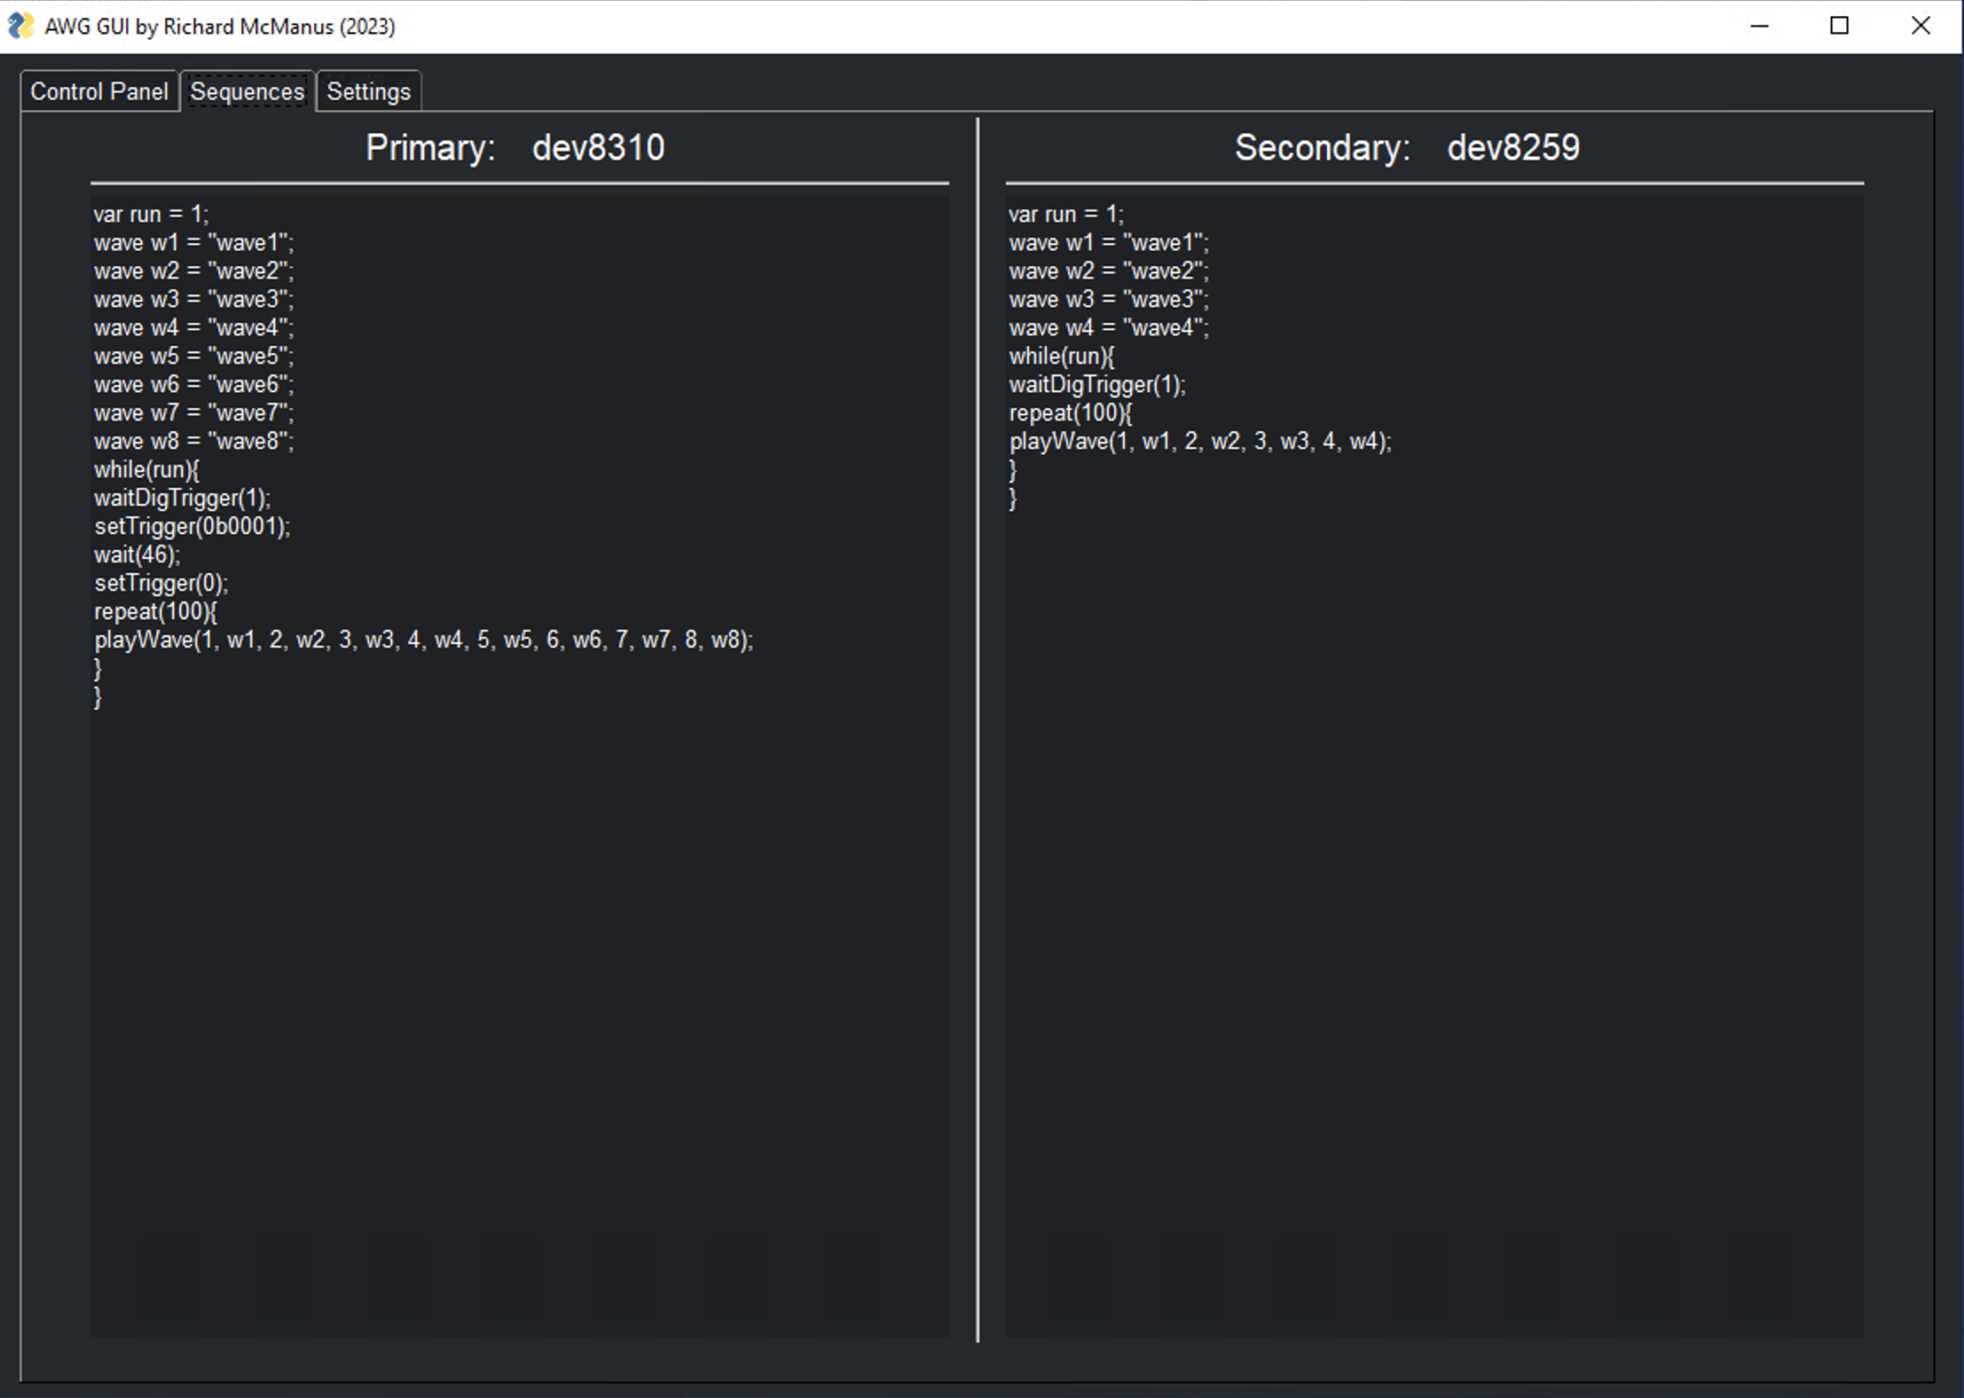
Sequences Tab
Displays primary and secondary sequences
Generated from control panel configuration
Uploaded to HDAWGs via Zurich’s Python LabOne API

Slide 4
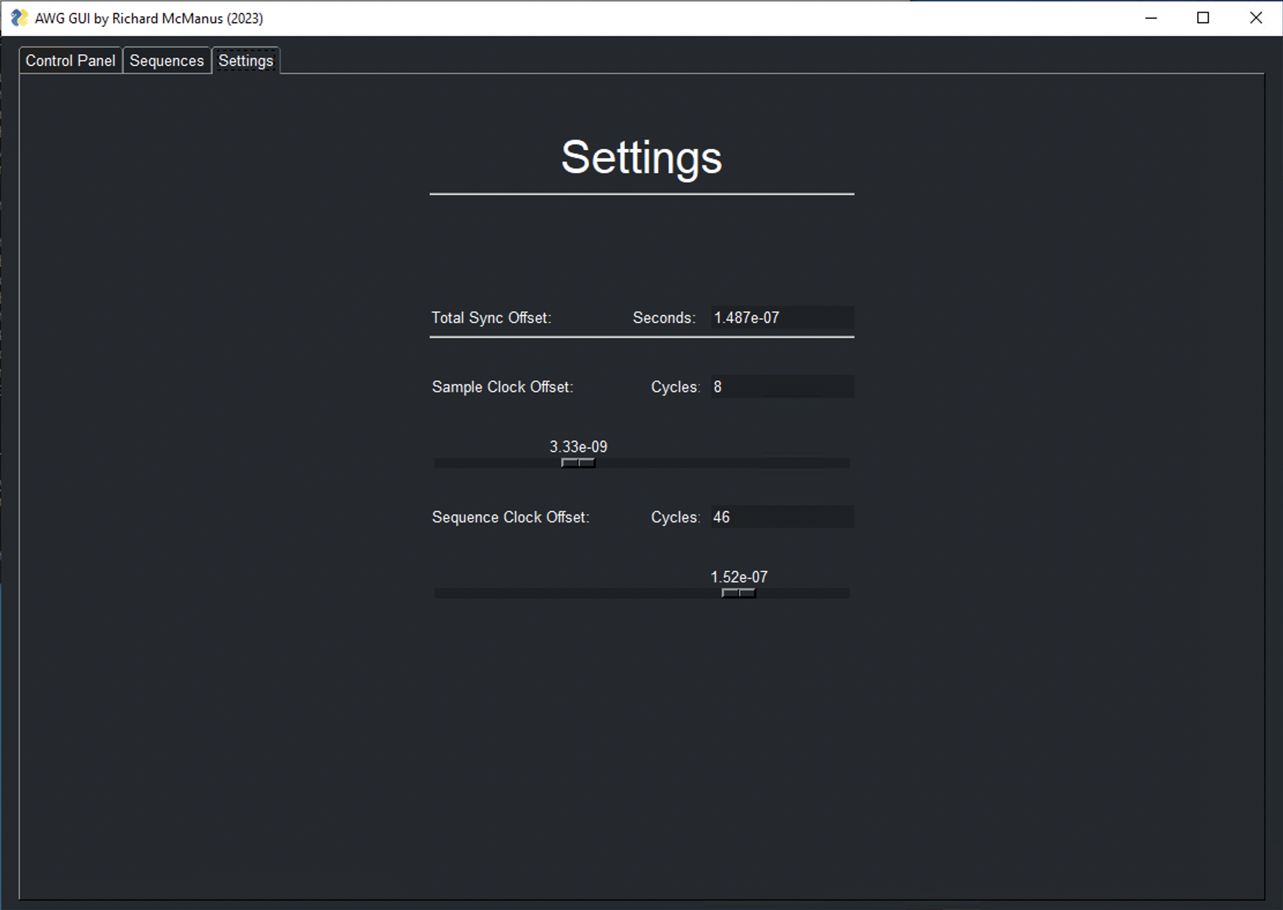
Settings Tab
Configures delay compensation
Sample Clock Offset rotates secondary device wave array
Sample Rate Dependent
Discrete values of 1/(sample rate)
0.4167 ns for 2.4 Gsps
Sequence Clock Offset delays primary device sequence
Discrete values of 3.33 ns
Total = Sequence - Sample

Slide 5
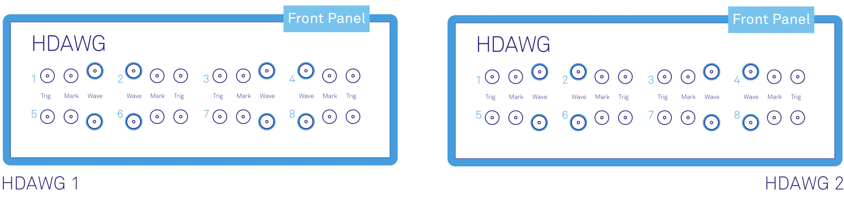
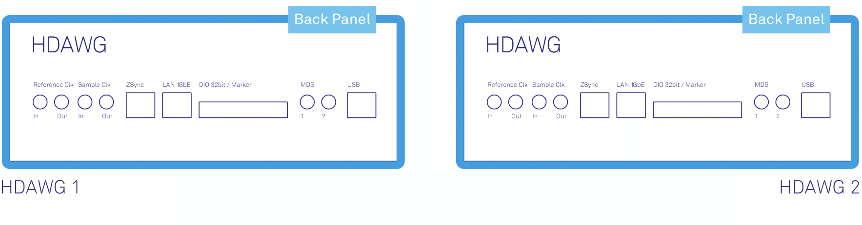
Common Configuration
Primary
Secondary
Front Panel
Sync Trigger
HDAWG 1, Mark 1 to HDAWG 2, Trig 1
Back Panel
Reference Clock
HDAWG 2, Reference Clk Out to HDAWG 1, Reference Clk In
Sync Trigger
Reference Clock

